Slide 1
CHAPTER TWO
Query Processing and Optimization

Slide 2
Learning Objectives
After completing this chapter you will be able to familiar with the following concepts:
Query Processing
Query processing steps
Query optimization
Query optimizer approaches
Transformation rules
Cost estimation approach for query
Pipelining
Prerequisite concepts for this chapter: Components of DBMS Environment, SQL and Relational Algebra and File Structures and Indexing.

Slide 3
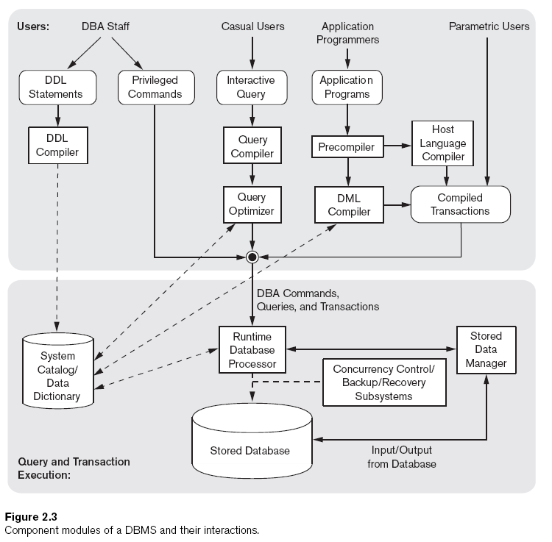
DBMS Components

Slide 4
DBMS Components
A DBMS is a complex software system. there are several types of software components that constitute a DBMS and there are different types of computer system software with which the DBMS interacts.
DBMS component modules
Divided into two parts
The top part of the figure refers to the various users of the database environment and their interfaces.
The lower part shows the internals of the DBMS responsible for the storage of data and processing of transactions.
The database and the DBMS catalog are usually stored on disk. Access to the disk is controlled primarily by the operating system (OS), which schedules disk read/write.
DBMS Component Modules
Buffer management:-schedule disk read/write
Stored data manager:- A higher-level of DBMS that controls access to DBMS information that is stored on disk, whether it is part of the database or the catalog.
DDL compiler:-processes schema definitions, specified in the DDL and stores descriptions of the schemas (meta-data) in the DBMS catalog.

Slide 5
DBMS Components
Interactive query interface
Query compiler:-queries are parsed and validated for the correctness of the query syntax, the names of files and data elements, and so on(compiles to internal form)
Query optimizer:-concerned with the rearrangement and possible reordering of operations, elimination of redundancies, and use of correct algorithms and indexes during execution.
Precompiler:- extracts DML commands from an application program written in a host programming language.
Runtime database processor:-executes
The privileged commands,
The executable query plans and
The canned transactions with runtime parameters.
System catalog:- data dictionary
stored data manager:-uses basic operating system services for carrying out low-level input/output (read/write) operations between the disk and main memory.
Concurrency control and backup and recovery system:-
Are integrated into the working of the runtime database processor for purposes of transaction management.

Slide 6
2.1. Overview of Query Processing and Optimization
Query processing is the activities involved in retrieving data from the database.
Its aims is to transform high-level language (SQL) into low-level language (relational algebra).
Query optimization is the activity of choosing an eﬃcient execution strategy for processing a query.
The aim of query optimization is to choose the one that minimizes the resource usage.
DBMS uses diﬀerent techniques to process, optimize, and execute high-level queries (SQL).
A query expressed in high-level query language must be ﬁrst scanned, parsed, and validated.

Slide 7
2.1. Overview of Query Processing and Optimization
The scanner identiﬁes the language components in the text of the query
The parser checks the correctness of the query syntax.
The query is also validated whether the attribute names and relation names are valid.
An internal representation (tree or graph) of the query is created.
Queries are parsed and then presented to a query optimizer, which is responsible for identifying an eﬃcient plan.
The optimizer generates alternative plans & chooses the plan with the least estimated cost.

Slide 8
2.2. Query Processing
Query: ask questions, especially in order to check if something is true. Retrievals of records.
Query Processing: The range of activities involved in extracting data from a database.
Includes translation of queries, query-optimizing transformations, and evaluation of queries.
Its aim is to find information in one or more databases and deliver it to the user quickly and efficiently.
Basic Steps in Query Processing:
1. Parsing and translation
2. Optimization
3. Evaluation
Parser &
Translator
Relational Algebra
Expression
Query
Optimizer
Query
Output
Evaluation Engine
Execution Plan
Data
Statistics About Data

Slide 9
2.2.1. Basic Steps in Query Processing
Step 1: Parsing and translation
System checks the syntax of the query.
Creates a parse-tree representation of the query.
Translates the query into a relational-algebra expression.
Parser checks syntax, verifies relations
Step2: Optimization: finding the cheapest evaluation plan for a query.
A query optimizer must know the cost of each operation.
Each relational-algebra operation can be executed by one of several different algorithms.
Step 3: Evaluation
The query-execution engine takes a query-evaluation plan, executes that plan, and returns the answers to the query.

Slide 10
2.2.1.1. Query Decomposition
Its aims is to transform a high-level query into a relational algebra query, and
To check that the query is syntactically and semantically correct.
Also, query decomposition consists of parsing and validation.
Typical stages or phases of query decomposition are:
Analysis,
Normalization,
Semantic analysis,
Simpliﬁcation, and
Query restructuring.

Slide 11
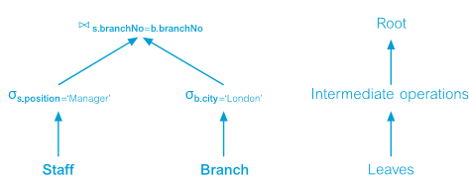
1. Analysis
It is lexical and syntactical analysis of the query correctness.
High-level query transformed into some internal representation that is more suitable for processing.
The internal form query tree, which is constructed as follows:
Query tree will be built for the query.
A leaf node is created for each base relation in the query.
A non-leaf node is created for each intermediate relation produced by a relational algebra operation.
The root of the tree represents the result of the query.
The sequence of operations is directed from the leaves to the root.

Slide 12
2. Normalization
Query processing converts the query into a normalized form that can be more easily manipulated.
The predicate WHERE will be converted to Conjunctive (v) or Disjunctive (^) Normal form.
Conjunctive normal form: A sequence of conjuncts that are connected with the ∧ (AND) operator.
Each conjunct contains one or more terms connected by the ∨ (OR) operator.
E.g. (position = ‘Manager’ ∨ salary > 20000) ∧ branchNo = ‘B003’.
Disjunctive normal form: A sequence of disjuncts that are connected with the ∨ (OR) operator.
Each disjunct contains one or more terms connected by the ∧ (AND) operator.
E.g. (position =‘Manager’ ∧ branchNo =‘B003’ ) ∨(salary >20000 ∧ branchNo =‘B003’).

Slide 13
3. Semantic Analysis
Its objective is to reject normalized queries that are incorrectly formulated or contradictory.
A query is contradictory if its predicate cannot be satisﬁed by any tuple.
Algorithms to handle contradictory clauses are:
Construct a relation connection graph
Construct a normalized attribute connection graph

Slide 14
4. Simplification
Its objective is to detect redundant qualiﬁcations, eliminate common subexpressions.
Transform the query to a semantically equivalent more easily and efﬁciently computed form.
In this stage, access restrictions, view deﬁnitions, and integrity constraints are considered.
5. Query Restructuring
The query is restructured to provide a more efﬁcient implementation.
More than one translation is possible use transformation rules.

Slide 15
2.3. Query Optimization
It is the activity of choosing an eﬃcient execution strategy for processing a query
The performance of a query is affected by the tables and by the complexity of the query.
The optimizer tries to select the most efficient (cheapest) access path for accessing the data.
DBMS is responsible to pick the best execution strategy based on various considerations.
Most efficient processing: Least amount of I/O and CPU resources.
Selection of the best method
For optimizing the execution of a query the programmer must know:
File organization.
Record access mechanism and primary or secondary key.
Data location on disk.
Data access limitations.

Slide 16
2.3.1. Approaches to Query Optimization: Heuristics Approach(HA)
HA to query optimization, which uses transformation rules to convert one relational algebra expression into an equivalent form that is known to be more efﬁcient.
HA uses the knowledge of the characteristics of the relational algebra operations and the relationship between the operators to optimize the query.
Thus the heuristic approach of optimization will make use of:
Properties of individual operators
Association between operators
Query Tree: a graphical representation of the operators, relations, attributes and predicates and processing sequence during query processing.
The properties of each operations and the association between operators is analyzed using set of rules called transformation rules.

Slide 17
2.3.2. Transformation Rules for the Relational Algebra Operations
By applying transformation rules, the optimizer can transform one relational algebra expression into an equivalent expression in more efﬁcient way.
In listing the rules, use three relations R, S, and T, with R deﬁned over the attributes A ={A1, A2, . . . , An}, and S deﬁned over B ={B1, B2, . . . , Bn};
p, q, and r denote predicates, and L, L1, L2, M, M1, M2, and N denote sets of attributes.

Slide 18
2.3.2. Transformation Rules for the Relational Algebra Operations
1. Conjunctive selection operations can cascade into individual selection operations (and vice versa). It is referred as cascade of selection.
σp∧q∧r (R) =σp(σq(σr(R))) where p, q and r are predicates
Example: σ branchNo=‘B003’ ∧ salary>15000(Staff) = σ branchNo=‘B003’(σ salary>15000(Staff))
2. Commutativity of Selection operations.
σ_{p}(σ_{q}(R))=σ_{q}(σ_{p}(R)) where p and q are predicates
Example: σ_{branchNo=‘B003’}(σ _{salary>15000}(Staff)) = σ_{salary>15000}(σ _{branchNo=‘B003’}(Staff))

Slide 19
2.3.2. Transformation Rules for the Relational Algebra Operations
3. Cascade of projection: In a sequence of Projection operations, only the last in the sequence is required.
Π _{L} Π _{M} ...Π _{N}(R) =Π _{L}(R)
Example: Π _{lNameΠ branchNo, lName}(Staff) =Π _{lName}(Staff)
4. Commutativity of Selection and Projection:
Π _{A1, . . . , Am}(σ _{p}(R)) =σ _{p}(Π _{A1, . . . , Am}(R)) where p ∈{A1, A2, . . . , Am}
Example: Π _{fName, lName}(σ _{lName=‘Beech’}(Staff)) =σ _{lName=‘Beech’}(Π _{fName, lName}(Staff))

Slide 20
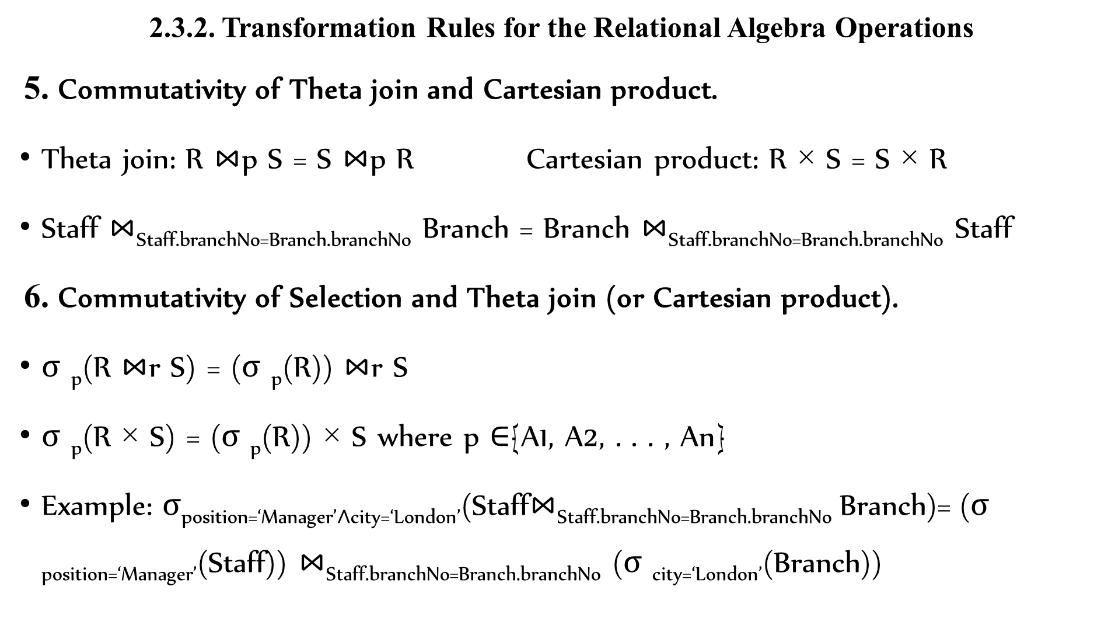
2.3.2. Transformation Rules for the Relational Algebra Operations
5. Commutativity of Theta join and Cartesian product.
Theta join: R $⋈$p S = S $⋈$p R Cartesian product: R × S = S × R
Staff $⋈$_{Staff.branchNo=Branch.branchNo} Branch = Branch $⋈$_{Staff.branchNo=Branch.branchNo} Staff
6. Commutativity of Selection and Theta join (or Cartesian product).
σ _{p}(R $⋈$r S) = (σ _{p}(R)) $⋈$r S
σ _{p}(R × S) = (σ _{p}(R)) × S where p ∈{A1, A2, . . . , An}
Example: σposition=‘Manager’∧city=‘London’(Staff$⋈$_{Staff.branchNo=Branch.branchNo} Branch)= (σ _{position=‘Manager’}(Staff)) $⋈$_{Staff.branchNo=Branch.branchNo} (σ _{city=‘London’}(Branch))

Slide 21
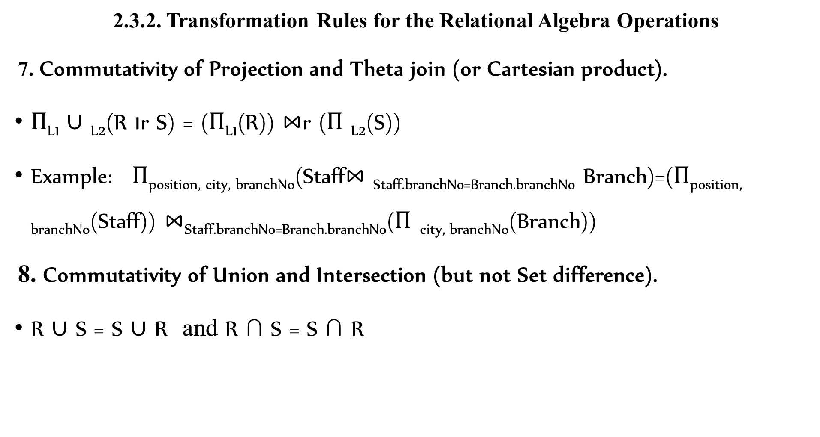
2.3.2. Transformation Rules for the Relational Algebra Operations
7. Commutativity of Projection and Theta join (or Cartesian product).
Π_{L1} ∪ _{L2}(R 1r S) = (Π_{L1}(R)) $⋈$r (Π _{L2}(S))
Example: Π_{position, city, branchNo}(Staff$⋈$ _{Staff.branchNo=Branch.branchNo} Branch)=(Π_{position, branchNo}(Staff)) $⋈$_{Staff.branchNo=Branch.branchNo}(Π _{city, branchNo}(Branch))
8. Commutativity of Union and Intersection (but not Set difference).
R ∪ S = S ∪ R and R ∩ S = S ∩ R

Slide 22
2.3.2. Transformation Rules for the Relational Algebra Operations
9. Commutativity of Selection and set operations (Union, Intersection, and Set difference).
σ_{p}(R ∪ S) =σ _{p}(S) ∪σ _{p}(R)
σ _{p}(R ∩ S) =σ _{p}(S) ∩σ _{p}(R)
σ _{p}(R − S) =σ _{p}(S) −σ _{p}(R)
10. Commutativity of Projection and Union.
Π _{L}(R ∪ S) =Π _{L}(S) ∪Π _{L}(R)

Slide 23
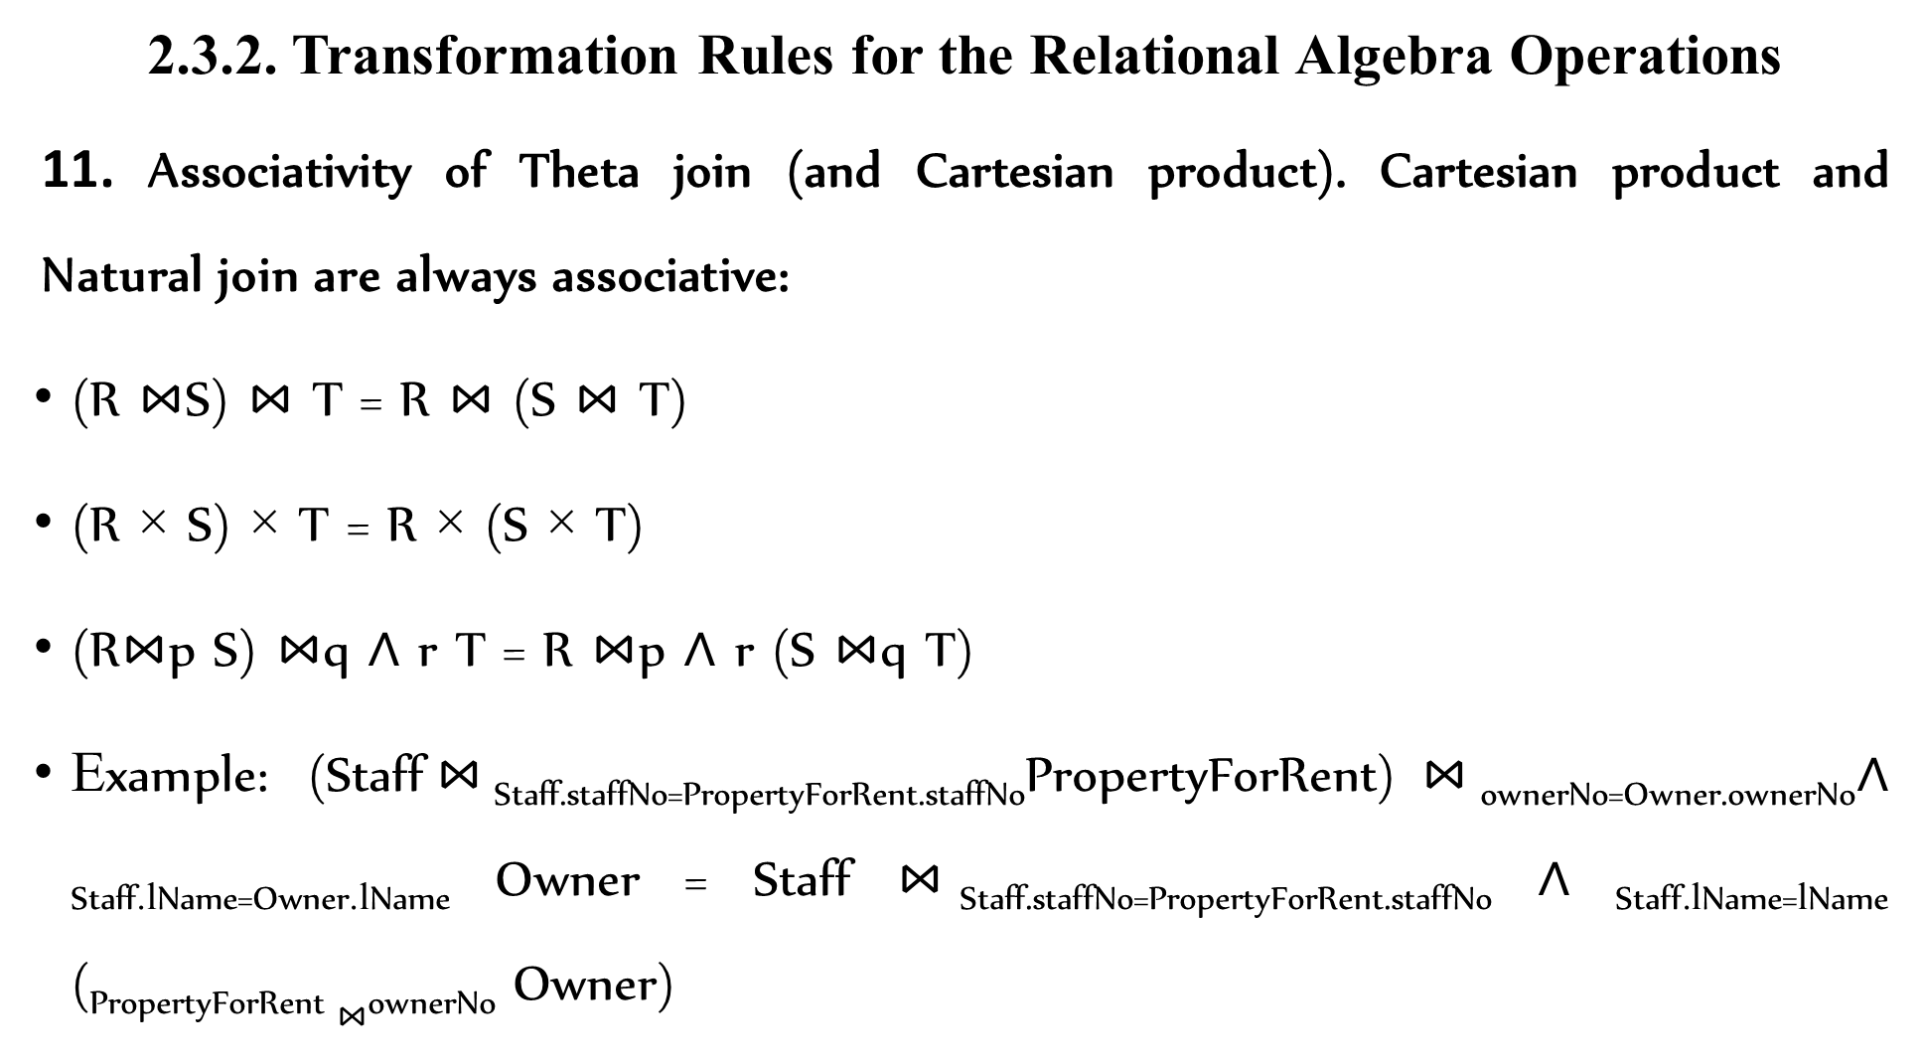
2.3.2. Transformation Rules for the Relational Algebra Operations
11. Associativity of Theta join (and Cartesian product). Cartesian product and Natural join are always associative:
(R $⋈$S) $⋈$ T = R $⋈$ (S $⋈$ T)
(R × S) × T = R × (S × T)
(R$⋈$p S) $⋈$q ∧ r T = R $⋈$p ∧ r (S $⋈$q T)
Example: (Staff$⋈$Staff.staffNo=PropertyForRent.staffNoPropertyForRent)$⋈$_{ownerNo=Owner.ownerNo}∧ _{Staff.lName=Owner.lName} Owner = Staff $⋈$Staff.staffNo=PropertyForRent.staffNo ∧ _{Staff.lName=lName} (_{PropertyForRent} $⋈$_{ownerNo} Owner)

Slide 24
Heuristic Approach will be implemented by using the above transformation rules in the following sequence or steps.
Sequence for Applying Transformation Rules are:
1. Step 1 use
Rule-1➔ Cascade Selection
2. Step 2 use
Rule-2: Commutativity of Selection
Rule-4: Commuting Selection With Projection
Rule-6: Commuting Selection With Join And Cartesian
Rule-10: Commuting Selection With Set Operations

Slide 25
Sequence for Applying Transformation Rules are:
3. Step 3 use
Rule-9: Associativity of Binary Operations (JOIN, CARTESIAN, Union and Intersection).
4. Step 4 use
Perform Cartesian Operations with the subsequent Selection Operation
5. Step 5 use
Rule-3: Cascade of projection
Rule-4: Commuting projection with selection
Rule-7: Commuting projection with Join and Cartesian
Rule-11: Commuting projection with Union

Slide 26
Main Heuristic
It is to first apply operations that reduce the size of the intermediate relation.
That is:
Perform selection as early as possible and Perform projection as early as possible
Example: consider the following schemas and the query, where the employee and the project relations are related by the works_on relation.
Employee (EEmpID, FName, LName, Salary, Dept, Sex, DoB)
Project (PProjID, PName, PLocation, PFund, PManagerID)
Works_on (WEmpID, WProjID)
WEmpID (employee identification) and WProjID (project identification) are foreign keys to WORKS_ON relation from Employee and Project relations respectively.

Slide 27
Query: The manager of the company working on road construction would like to view employees name born before January 1 1965 who are working on the project named Ring Road. Relational Algebra representation of the query will be:

Slide 28
The initial query tree will be:
_{<FName, LName>}
(DoB<Jan1 1965) ∧(WEmpID=EEmpID)∧ (PProjID=WProjID)∧(PName=’Ring Road’)
X
X
Project
Employee
Works_On

Slide 30
Using the third step, perform most restrictive operations first.
From the query given we can see that selection on Project is most restrictive than selection on Employee.
Thus, it is better to perform selection on project before selection on employee.
Rearrange the nodes to achieve this.

Slide 31
Using the forth step, Perform Cartesian Operations with the subsequent Selection Operation.

Slide 32
Using the fifth step, Perform the projection as early as possible.

Slide 34
2.3.3. Cost Estimation Approach to Query Optimization
The main idea is to minimize the cost of processing a query.
The cost function is comprised of:
I/O cost + CPU processing cost + communication cost + Storage cost
These components might have different weights in different processing environments.
The DBMs will use information stored in the system catalogue for the purpose of estimating cost.
Query optimization minimize the size of the intermediate relation.
The size will have effect in the cost of:
Disk Access
Data Transpiration
Storage space in the primary memory
Writing on Disk

Slide 35
2.3.3. Cost Estimation Approach to Query Optimization
The statistics in the system catalogue used for cost estimation purpose are:
Cardinality of a relation: the number of tuples contained in a relation currently (r)
Degree of a relation: number of attributes of a relation
Number of tuples on a relation that can be stored in one block of memory
Total number of blocks used by a relation
Number of distinct values of an attribute (d)
Selection Cardinality of an attribute (S): that is average number of records that will satisfy an equality condition S=r/d
Calculate the cost of executing a query and selecting the best strategy, which is with the minimum cost of processing.

Slide 36
2.3.3. Cost Components for Query Optimization
The costs of query execution can be calculated for the following major process we have during processing.
Access Cost of Secondary Storage.
The disk access cost can again be analyzed in terms of:
Searching
Reading, and
Writing, data blocks used to store some portion of a relation.
The disk access cost will vary depending on the file organization used & the access methods

Slide 37
2.3.3. Cost Components for Query Optimization
Storage Cost: The intermediate results should be stored in primary memory for further processing.
The bigger the intermediate relation, the larger the memory requirement.
Computation Cost: Query is composed of many operations.
Searching, Sorting, Merging, Computation on field values
Communication Cost: The cost of transporting data between the database site and the terminal.

Slide 38
2.4. Pipelining
Pipelining is another method used for query optimization.
It used to improve the performance of queries.
It is sometime known as stream-based processing or queries.
As query optimization tries to reduce the size of the intermediate result.
Pipelining uses a better way of reducing the size by performing different conditions on a single intermediate result continuously.
Thus the technique is said to reduce the number of intermediate relations in query execution.
Pipelining performs multiple operations on a single relation in a pipeline.

Slide 39
THANK YOU

